Slide 1
MAX How-To
Work with MAX files using different tools
Excel, Sparx EA, Access , Eclipse
Excel & Access 2010
Sparx EA 10 (8 and 9 should also work)
Eclipse Juno
Michael van der Zel - v2 May 5th, 2015
New featuers in 2015.
Added BASE64 version of embedded document.

Slide 2
Contents
TODO: Why MAX? Why not XMI?
The “MAX format”
Working with MAX files from Excel
  This guide shows how to import a basic MAX XML file objects and relationships into Excel.
  Export to MAX
  Advanced: Handling object attributes and object and relationship tagged values
    XML Transforms
    excel-to-full-max.xslt
      Use tag.value.<tagname> for short values
      Use tag.notes.<tagname> for long values (>255 chars)
  TODO: Matrix using PivotTables
TODO: Working with MAX files using Sparx EA
  Installing
  All the Extension functions: Import/Update, Export (Diagram to select / Package), Transform, Validate, ...
TODO: Working with MAX files using Eclipse
TODO: Working with MAX files using Access
TODO: Creating a MAX file from HL7 MIF

Slide 3
Why MAX? Why not XMI?

Slide 5
The “MAX format”
Complete and Excel Compatible version

Slide 6
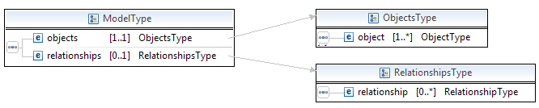
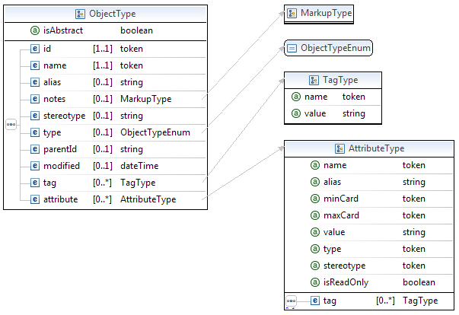
MAX Schema
Allows XHTML to be used.
Value is <256 chars
Notes as content >255
Notes as content >255

Slide 7
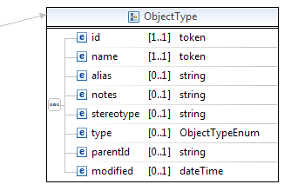
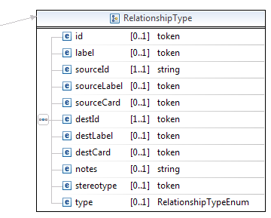
Excel Compatible
Differences with Full MAX:
- Notes are simple strings instead of MarkUp
- Complex tags are replace with:
tag.value.<tagName> = <value>
tag.notes.<tagName> = <value >255 chars>
- Attributes are done similar:
attribute.<attName>.name
attribute.<attName>.alias
attribute.<attName>.minCard
etc.

Slide 8
Object
id (required) - unieke id (bij voorkeur een GUID), voor gebruik in parentId en sourceId/destId
name (required) – name
alias - alternative name (e.g. short name)
notes – description
stereotype – more detailed object type (commonly used to select set of tags)
type – see object types (default=Class)
parentId – used to create a tree structure
modified – last change in XML format (2013-11-29T00:00:00)
tag(multiple) – see Tag type
attribute(multiple) – set Attribute type

Slide 9
ObjectTypes
Class(default)
Object - instance of a Class
Feature, Requirement – used e.g. for a system features
Package – container of objects, like a file folder
Interface - interface of a Class or Component
Component – used e.g. for a service, application or module
Note, Text, Boundary – used in diagrams
Artifact
Issue, Change
Action, Activity – used in activities
Constraint
Enumeration – classes that have stereotype enumeration

Slide 10
Relationship
id – not used yet (future: used for relationship object)
label – label visible on the relationship
sourceId(required) – source object id
sourceLabel – source label
sourceCard – source cardinality, e.g. 0..1, 1..1, 1..*, 0..*
destId(required) – destination object id
destlabel – destination label
destCard – destination cardinality, e.g. 0..1, 1..1, 1..*, 0..*
notes – description
stereotype – more detailed object type (commonly used to select set of tags)
type – see relationship types (default=Association)
tag(multiple) – see Tag type

Slide 11
RelationshipTypes
Association(Default) – there is some relationship between the objects
DirectedAssociation – same as association but with an arrow to destination
Dependency – source depends on destination
Aggregation – source is separable part of destination
Composition – source is part of destination
Generalization – source is specialization of destination
Realization – source is a realization of the destination, e.g. a Component can be a realization of a Requirement or Feature
InformationFlow – flow of information from source to destination
Package
NoteLink – used in diagrams to link a Note

Slide 12
Tag

Slide 13
Attribute

Slide 14
Working with MAX files using Excel
Import

Slide 15
Excel – EA Roundtrip
Excel → MAX Excel XSD (+ added tags) → MAX Simplified → Eclipse to_full xslt → MAX Full → EA → MAX Full → Eclipse simplify xslt → Excel Simplified XML → Excel
Simpl.
MAX
.xml
XSLT runner
(Eclipse)
Full
MAX
.xml
Excel Spreadsheet
Export
Ìnput
Output
Import
to_full.xslt
Import
Excel
XSD
Simpl.
MAX
XML
XSLT runner
(Eclipse)
EA + MAX Extension
Output
Full
MAX
XML
Export
to_full.xslt
Input

Slide 16
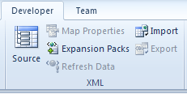
UC1: MAX Import Excel
Once: Show the Developer/XML Tab on the Ribbon
http://office.microsoft.com/en-us/word-help/show-the-developer-tab-HA101819080.aspx
Add XML Map = Load the XML Schema (1,2,3,4)
Bind elements to columns (6)
Import (7)
Et Voila

Slide 17
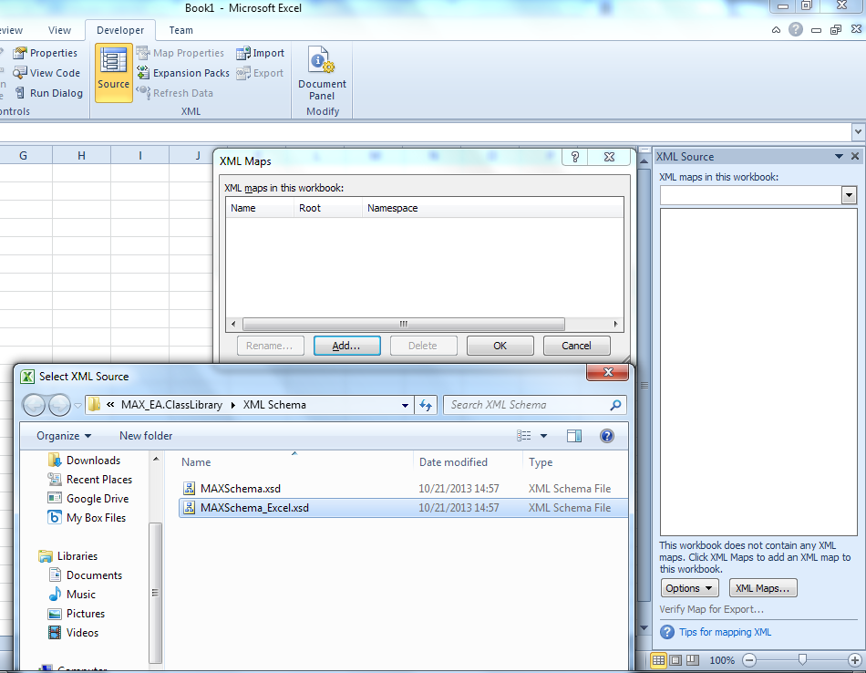
1
3
4
2

Slide 18
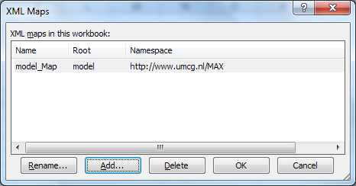
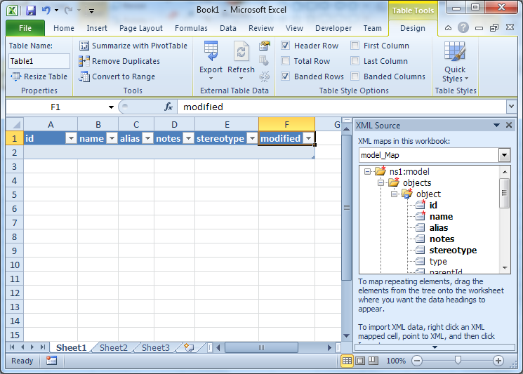
5
6

Slide 19
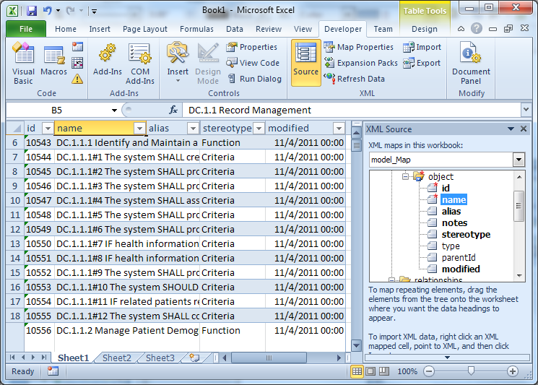
7

Slide 20
MAX Simplified to Excel
Export using the MAX Transform function
xslt: simplify-max-for-excel.xslt
Then import in Excel directly using UC1, but in step 3 select the XML and NOT the Schema

